Slide 1
Data Understanding-Confirmed US State-Level
Winfred

Slide 2
Data Quality
Part I

Slide 3
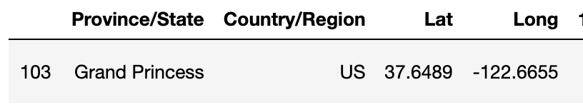
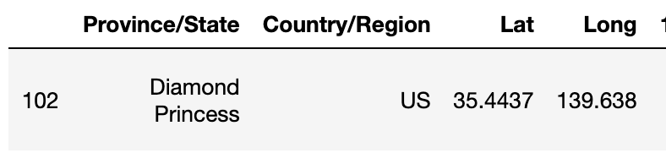
Outliers
These two records do not belong to any state in US.
I filter out these two records for following analysis.

Slide 4
Latest(3/18/20) Confirmed Cases by State
Part II

Slide 5

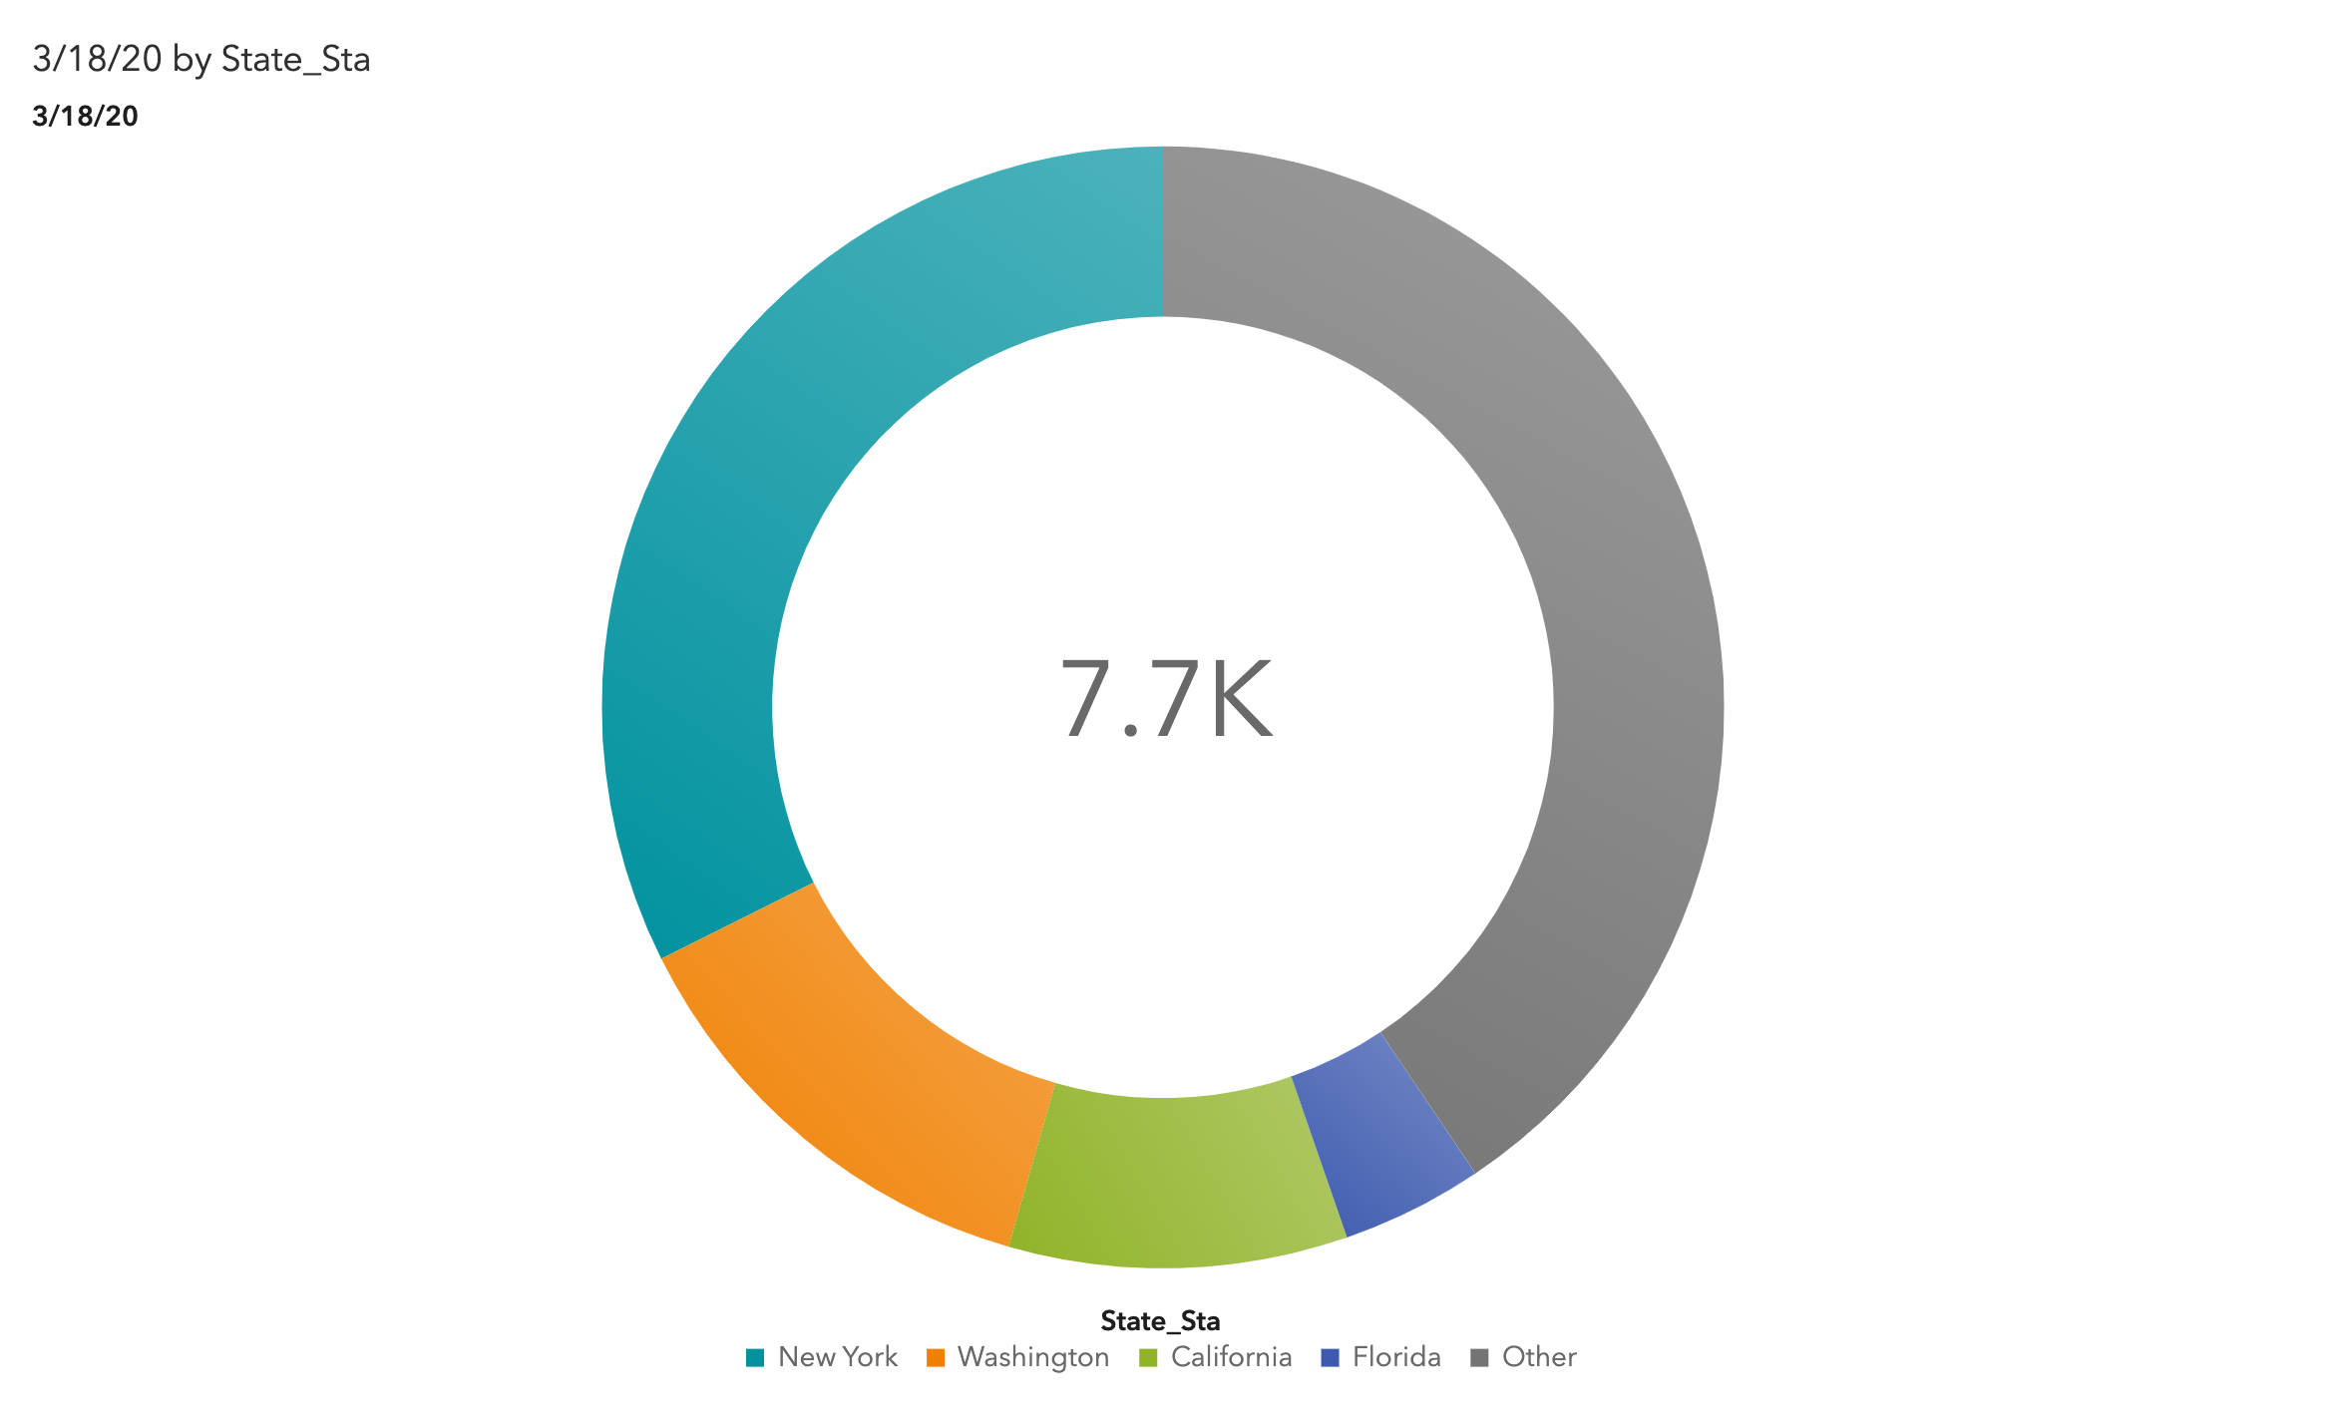

Slide 6
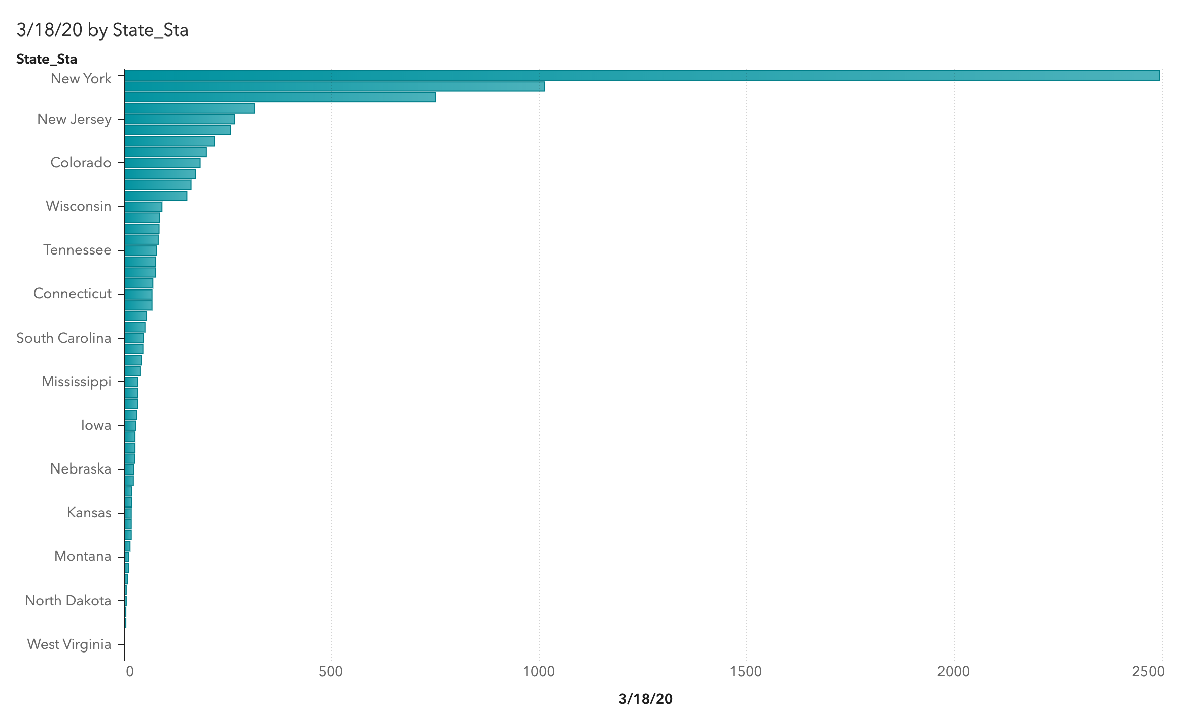

Slide 7
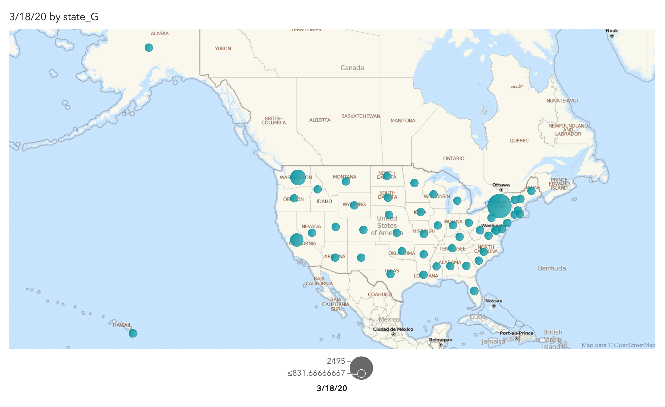

Slide 8
Confirmed Cases in Severely affected cities
Part III

Slide 9
